Slide 1

Digital Collection Accessibility Solution
NYU + NYPL
Abhijeet Sant (ars1125), Nikita Amlani (nga261)
Rohit Saraf (rs6785), Shreya (ss13337)

Slide 2
Introduction
Our solution aims at providing an end to end system that provides NYPL ability to generate alt text for images in their Digital Collection.
The interface will allow users to upload an image to generate alt text for it, generate alt text in batch for all recently added images and ability to retrain the model with the newly added data.
This solution aims at improving accessibility for the library by automating the process of alt text generation.
Notes:
Xception by google stands for Xtreme version of Inception is a CNN-LSTM based model .

Slide 3
Steps to achieve our solution
Load and pre-process images of a digital collection (Farm Security Administration) using the NYPL API.
Generate alt text using a pretrained model by Facebook Research. This gave us alt text for training our own CNN model.
Train our own VGG16 model using the generated alt texts
Evaluate the model using Bilingual Evaluation Understudy Score(BLEU)
Our trained model evaluated to the score of 0.66
Notes:
Xception by google stands for Xtreme version of Inception is a CNN-LSTM based model .

Slide 4
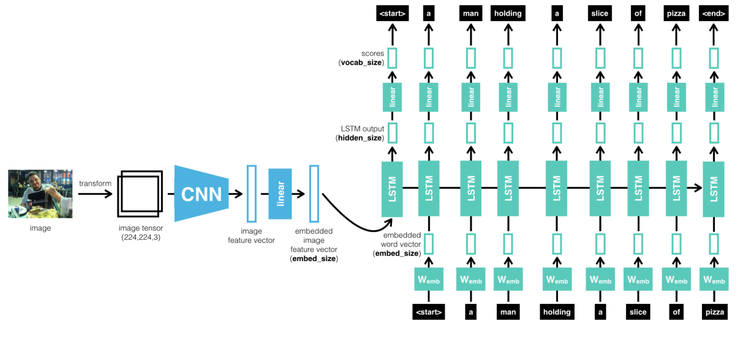
General structure of CNN LSTM model
Notes:
Images from FSA collection were taken and transformed into an image tensor. CNN (Convolution Neural Network) technique was applied to get an image feature vector. We used LSTM on this image feature vector to generate captions i.e. alternative text to describe the contents of the image.

Slide 5
Interface
We created a Python flask application with front end in JQuery, HTML and CSS which gives multiple options to the users.
The users can upload any image they want to generate alt text for.
The model is used to predict the alt text and it can be edited by the user and saved for future retraining of model.
The interface also gives ability to retrain the model and generate alt text for all recent images.

Slide 6
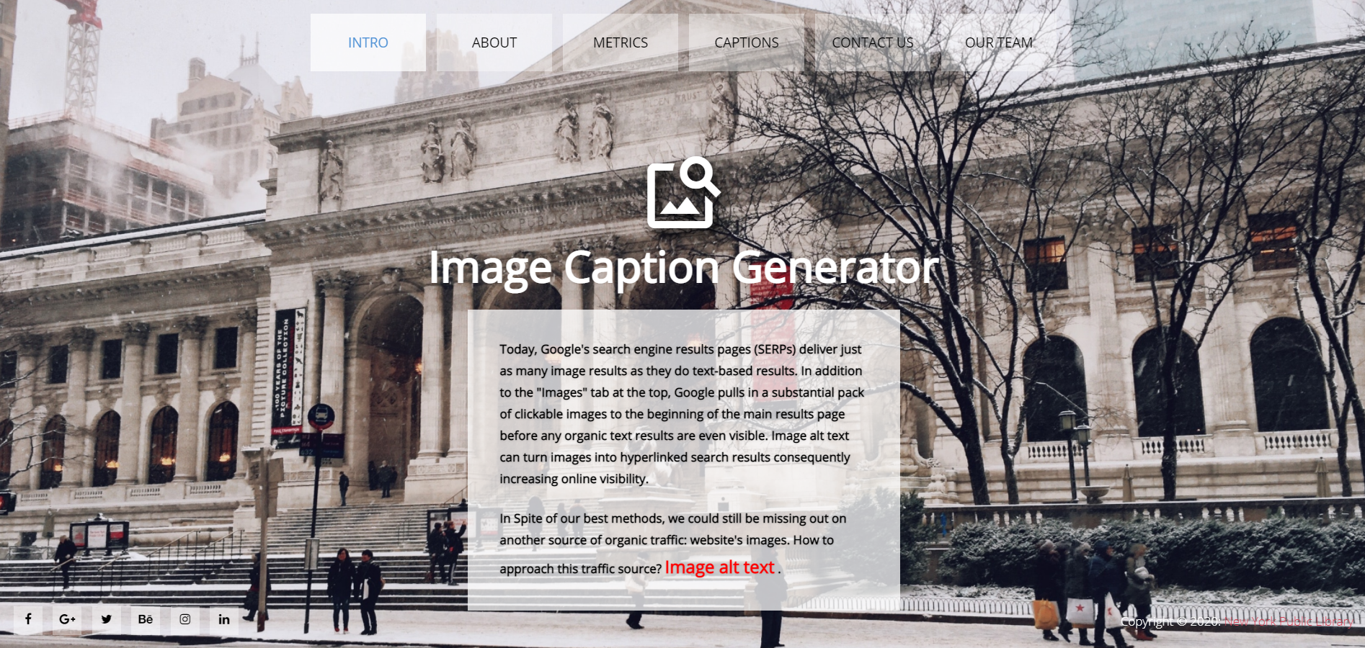
Interface

Slide 7
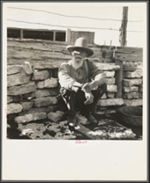
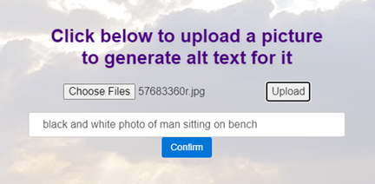
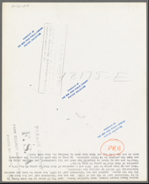
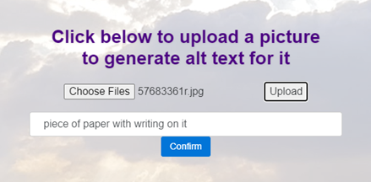
Generating Alt Text

Slide 8
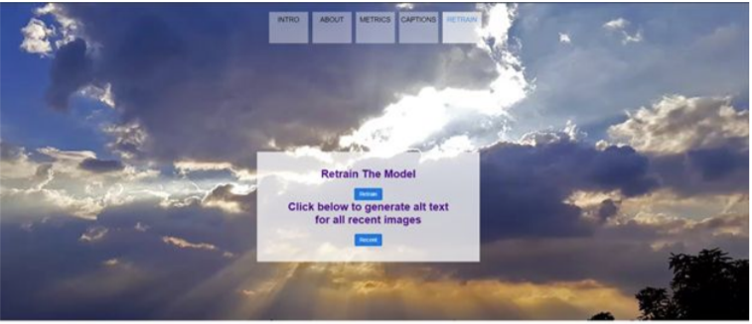
The Interface also provides ability to retrain the model

Slide 9
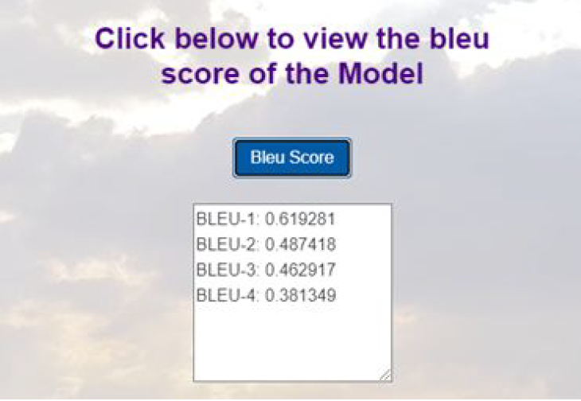
Testing the performance of the model using BLEU score

Slide 10
Technologies Used
We have used the following technologies to achieve our results
Front-end - JQuery , HTML,CSS, Bootstrap
Backend-Python
Model implementation - Python , HPC server, Google Colab

Slide 11
Thank you!

